Slide 1


Cloud Performance Analysis and Benchmarking Best Practices
Mike Jung – Director of Consulting
mike@cloudspectator.com

Slide 2

whoami
Current: Director of Consulting @ Cloud Spectator
Past: Product Manager, Senior Solutions Engineer and Sys Admin @LiquidWeb
7+ years experience working with Cloud Benchmarking and Performance Tuning
Passions
Performance Tuning / Benchmarking
Helping Businesses Grow
Website / Wiki - https://wiki.mikejung.biz

Slide 3

Why I’m Here
Share some challenges and painpoints that Cloud Spectator has observed over the past year when it comes to the cloud
To talk about why benchmarking matters and is relevant
Provide some tips for benchmarking VM compute and storage
Offer up a new way to view cloud performance and value
Answer any questions you may have about anything cloud!

Slide 4

Cloud Industry Challenges - Innovation
*New technologies emerging faster and faster each day
*This drives demand for new cloud services, product offerings mainly based customer demand
*Do you wait for new technology to be “stable” or do you hop on early adopter wave?
*How can you be sure you are making the right choice?

Slide 5

Cloud Industry Challenges – Changing Requirements
*Many enterprises and small businesses focus on being agile to stay competitive, this oftentimes means that what worked last week won’t work tomorrow
*If competitors are leveraging new tech they might have an advantage over those that are “behind the times”
*How do these changes impact performance or cost?
*But what about containers??

Slide 6

Cloud Industry Challenges – Complex Products and Pricing
*Cloud Pricing / Cost is not always an easy thing to figure out
*Often times the expected spend and actual spend don’t match up
*Trying to compare the pricing between two or more clouds can be head spinning
*Cloud Spectator is tackling this challenge with our Cloud Transparency Platform (shameless plug)
Notes:
Pace = touch on recent example of innovation / things that have impacted cloud perf in general, these things happen more and more frequently.
-nvme
-amd epyc
-spectre/meltdown

Slide 7

The Need for Cloud Transparency
Clearly there are many challenges for enterprises using or moving to the cloud
Measure three times, cut once – don’t just move because everyone else is…make sure you understand what you are moving to!
Having access to transparent data around cloud performance and pricing can save you lots of headaches and dollars in the future!
Benchmarking price and performance can go a long way here

Slide 8
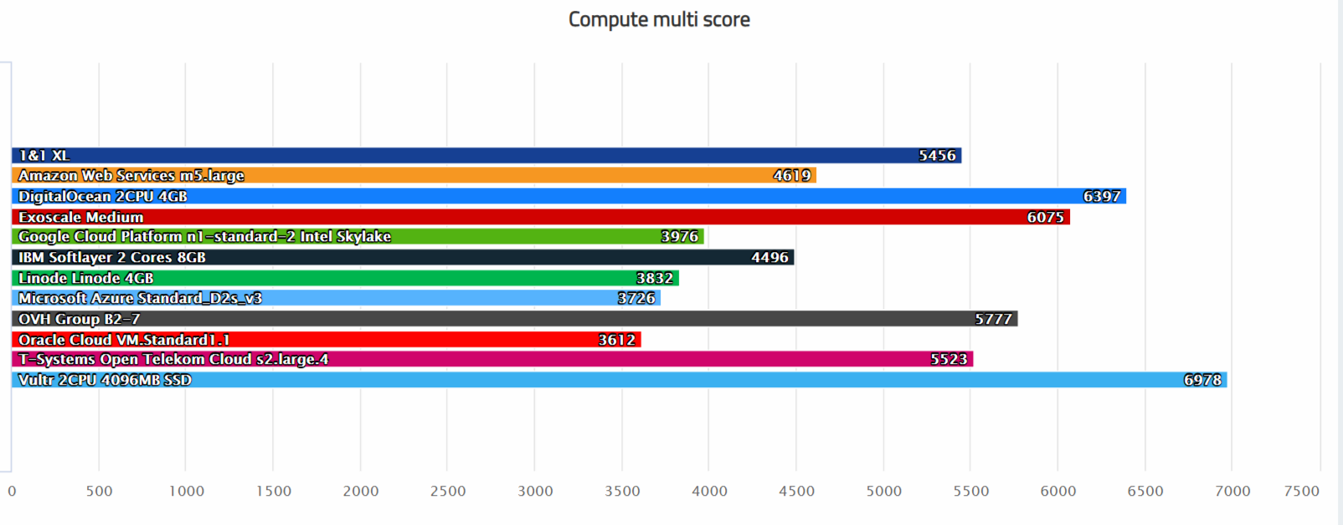
Transparency – All clouds are equal right?
*Cloud Spectator specializes in validating performance claims and bringing transparent data to the enterprise
*On paper most cloud infrastructure appears similar
*Performance and Pricing all over the place for similar spec’d VMs
*VM performance is only one aspect, PaaS and SaaS also show large difference in performance
*Head hurt yet?
Notes:
-nvme
-amd epyc
-spectre/meltdown

Slide 9


Comparing Apples to Apples
Comparing similar Cloud services from various providers can seem like comparing apples to oranges.
Decide what matters to you most
Control?
Performance?
Price?
Support?
Ease of use?
Focus on identifying infrastructure that meets your min. requirements, then compare performance and pricing between your top 5 – 10 options

Slide 10





Evaluating Cloud Providers – Other Considerations
Regions and countries that providers operate in matter on the business level
Data center locations – hardware differences, temps, latency
Size and business stability – perf doesn’t matter if your boss won’t go with a small cloud
Security and risk
Reliability and trustworthiness
Audit and compliance opacity
Pricing models and contract terms
Service-Level Agreements (SLA)
Ease of use, self-service, robust API

Slide 11
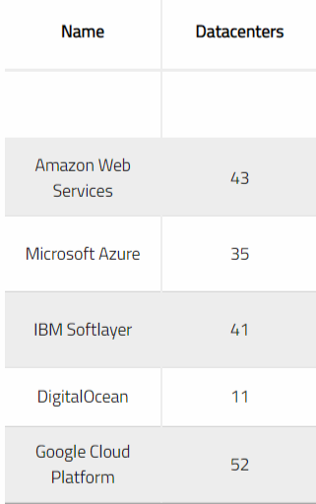
Evaluating Cloud Providers – DCs
Largest providers many times have 10+ locations
Performance and Price can vary between location
Availability Zones generally have similar price/perf, but always good to test

Slide 12
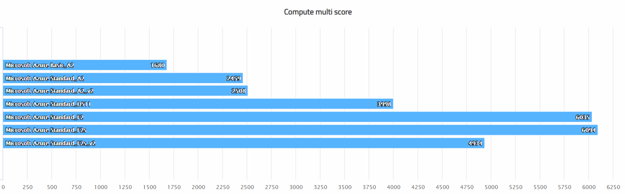

Evaluating Cloud Providers – CPU perf Azure
-Clearly not all CPUs are equal on Azure
-Large performance difference between VM series
-Azure F series perf varies greatly between F models

Slide 13
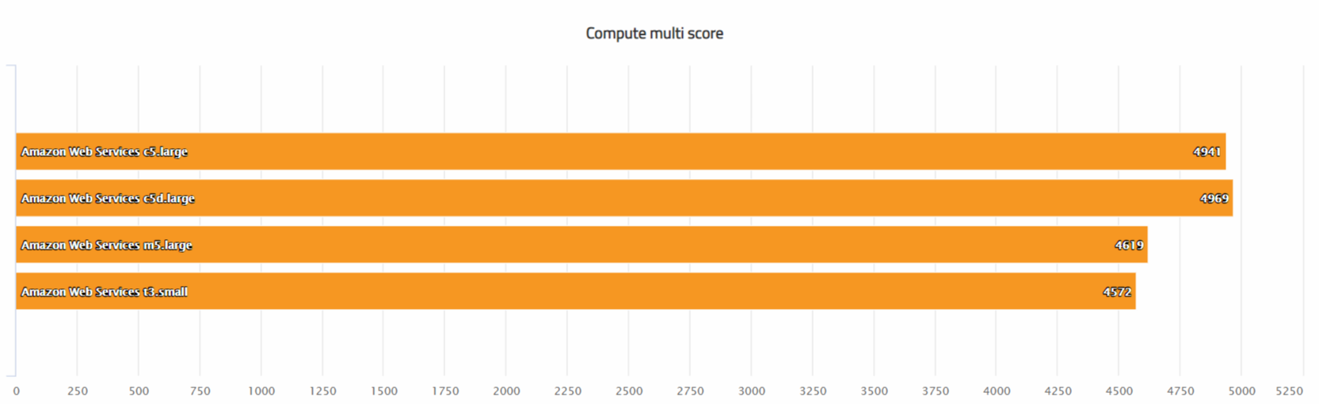
Evaluating Cloud Providers – CPU perf AWS
-AWS offers slightly less variation between VM series compared to Azure
-T3 burstable VMs add another layer of complexity, measure burst or not?

Slide 14
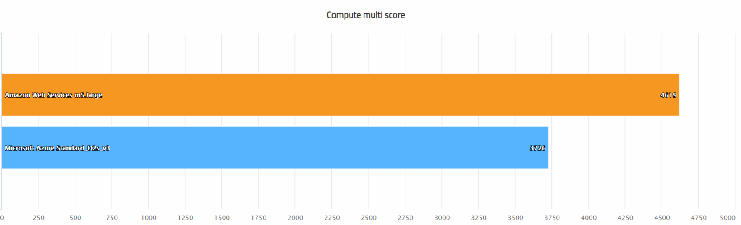
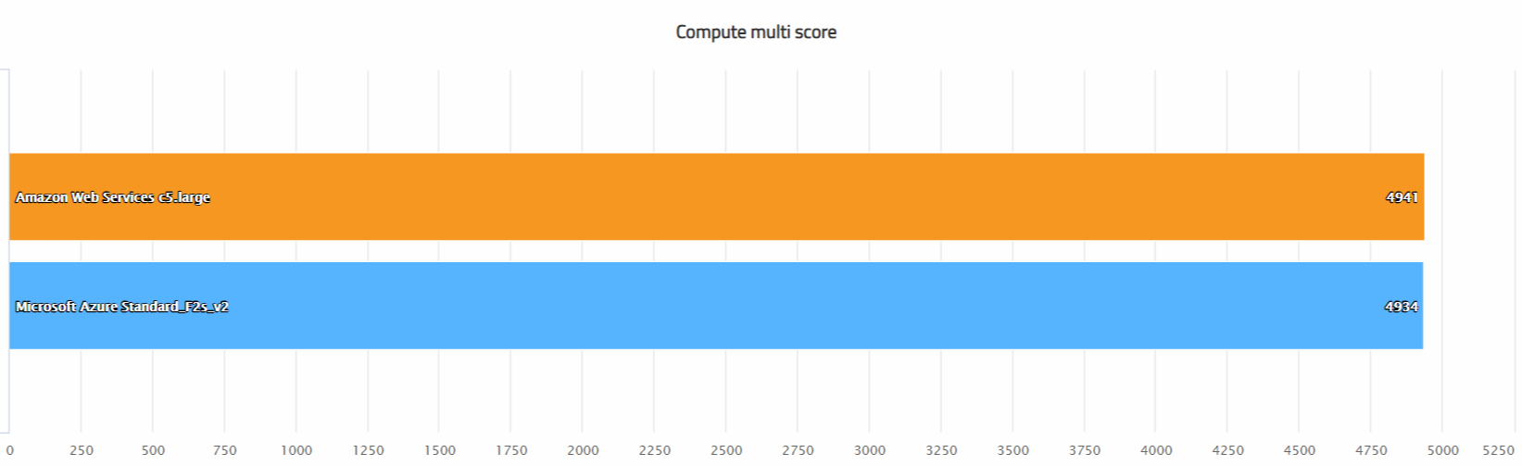
Evaluating Cloud Providers – General and Compute CPU perf
-AWS offers slightly less variation between VM series compared to Azure
-T3 burstable VMs add another layer of complexity, measure burst or not?
General Purpose – 40% perf diff between AWS and Azure!
Compute Optimized – Very similar performance

Slide 15

Why Benchmarking?
If you can measure it you can improve it!
VM CPU and DISK performance is not static, is ever changing
Not all clouds use the same hypervisor or configuration settings
Getting work done in the cloud costs money, therefore getting work done as quickly or efficiently as possible is key

Slide 16
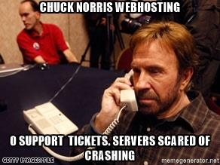
Why Benchmarking? – part 2
Your customers care about performance!
Faster servers usually mean faster apps, which can mean more engagement
Tons of free tools out there, doesn’t have to be expensive or time consuming
Use benchmarking data to retain clients – the cloud is competitive any value adds are welcome!
Price and Performance make a great pair

Slide 17

Benchmarking Storage with FIO
Excellent tool for stressing out storage
Random Read - seems to be most common
Random Write - my favorite metric
Databases and apps need to write to disk, sometimes causes a lock = I/O wait = Load
95th percentile response times
https://github.com/axboe/fio

Slide 18
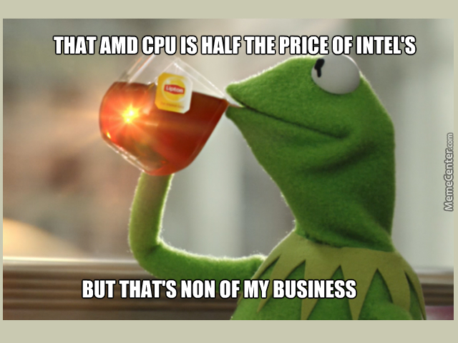
Benchmarking CPU/vCPU with GeekBench
Commercial tool but worth the price if you do a lot of benchmarking
Easy to run and compare results regardless of specifications
vCPUs are arbitrary - GeekBench MultiCore result is not
Single Socket generally provides highest performance
Multi Core doesn’t seem to scale as well
http://geekbench.com/

Slide 19
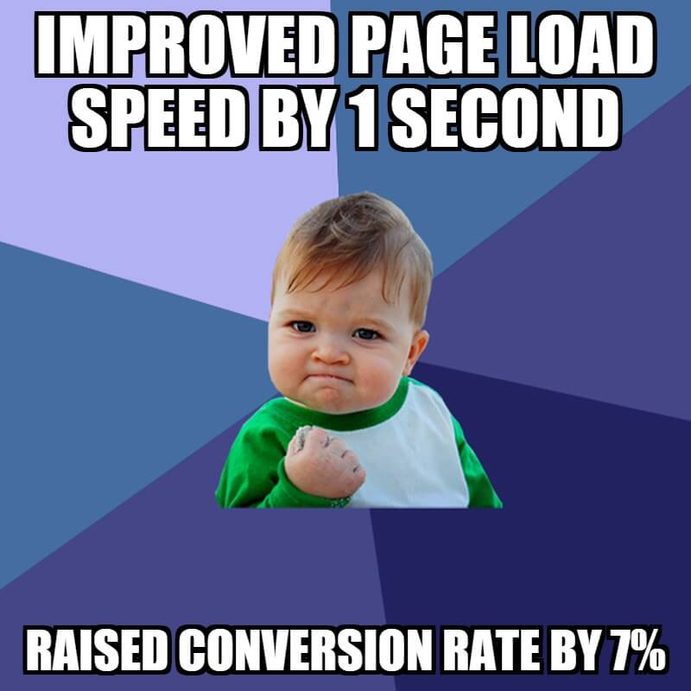






Benchmarking Up the Stack - Web
Start with what matters, your businesses or your customer’s site / app!
Monitor website performance regularly.
Load Test / DoS your servers / infrastructure before going live (let your provider know first!)
Commercial tools like LoadStorm make it easy to impress your clients
Can also use free software like Siege and ApacheBench
Resource / APM help figure out what magic formula is
Don’t just look at numbers and be done, act on / improve this, explain to your customers

Slide 20
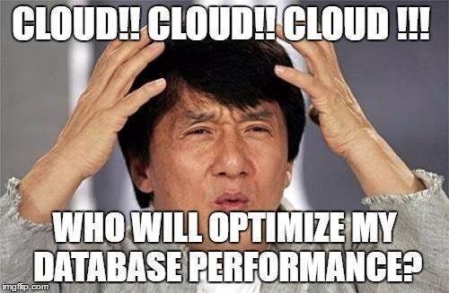
Benchmarking Database with Sysbench OLTP
Helps provide a somewhat standard baseline
Don’t guess if a setting helped, test and measure!
Has OLTP Read-Only, Read/Write, Transactional, many other modes
Also used as a second opinion for Disk I/O benchmarks
https://github.com/akopytov/sysbench

Slide 21

Benchmarking Everything Else with Phoronix
100+ benchmarks to run
Apache, Nginx, PHP are a few relevant ones
Great for a quick, basic benchmark
Not the best tool for extensive / in depth benchmarking (imho)
https://www.phoronix-test-suite.com/

Slide 22

Determining Cloud Value – The Universal Metric
Solving a business or customer problem is always good, but how do you overdeliver?
Focus on value and efficiency!
Cloud price-performance is an easy value to calculate.
Value (bang for your buck or performance obtained per dollar spent) sheds much more light on pure price or performance metrics
Once you have all three metrics you can decide where you want to optimize.
Performance / Price = Value

Slide 23
Cloud Price-Performance Example: Price
Step 1 - Identify Hourly or Monthly pricing (whichever is more applicable)

Slide 24
Cloud Price-Performance Example: Performance
Step 2 - Measure CPU or Disk Performance

Slide 25
Cloud Price-Performance Example: Perf/Price
Step 3 - Divide Performance by Price and compare your options

Slide 26
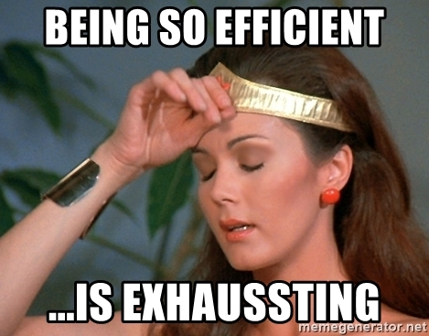
Performance Per Dollar Spent: Recap
Measure CPU or Disk Performance
Identify hourly or monthly price
Divide performance by price
Example:
Storage Vol 1 has 5000 iops @ $10/mo = 500 iops per dollar spent
Storage Vol 2 has 25,000 iops @ $100/mo = 250 iops per dollar spent
If you need 25,000 iops you could just buy 5x Vol 1, raid together and have same perf as vol 2 but at half the cost (benchmark the RAID 0 to confirm)

Slide 27
Things to look out for in the future
As the world moves to the cloud, “performance per dollar spent” will be increasingly important.
Machine Learning for analysis and constant monitoring
Automated cloud arbitrage – always have the best bang for your buck
CPU wars are back?!?! AMD Epyc will hopefully make the CPU space competitive again – more perf for the consumer!

Slide 28

Things to Do Tomorrow
Benchmark your current infrastructure (not in production!)
Benchmark any alternative options
Confirm that you’re getting the most bang for your buck

Slide 29
Thank You!
Questions!
Questions?
Mike Jung
mjung@liquidweb.com

